Slide 1

FudgeMart and FudgeFlix Integrated Data Warehouse and Integration for Sales
By-Group 1

Slide 2

Project Team
Data Engineer
Venkata Siva Bhargav Konakanchi
Data Engineer and Analyst
Dixitha Kasturi
Project Manager
Aishwarya Dhanda
BI Analyst
Shannon Gambuti

Slide 3
AGENDA
Introduction
01
Business Process
02
ETL
(Extract-Transform-Load)
03
Data Visualizations
04
Recommendations
05

Slide 4
Introduction
FudgeMart
Fudgemart is a hypothetical internet shop similar to Amazon.com or Walmart.com. The data comprises customers, items, and vendors, and the business operations are identical to those found in any online retailer.
FudgeFlix
Fudgeflix is a hypothetical online DVD-by-mail and video-on-demand service similar to Netflix. It relates to knowledge like accounts, subscriptions, video titles, and other aspects of an online video streaming service.

Slide 5

Business Process – improve Sales
Business Requirements & Goals:
Merge the two databases of Fudgemart and Fudgeflix to make them one
Focus on sales of the new company
What are the Sales generated by top 5 customers by category?
What are the Regions contributing to sales?
What are the Sales generated over time by category and source company?
Identify scope of improvements and patterns if any

Slide 6
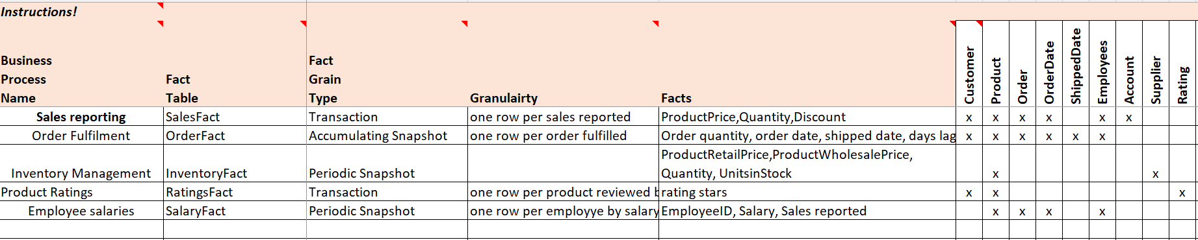
HIGH LEVEL DIMENSION MODEL

Slide 7
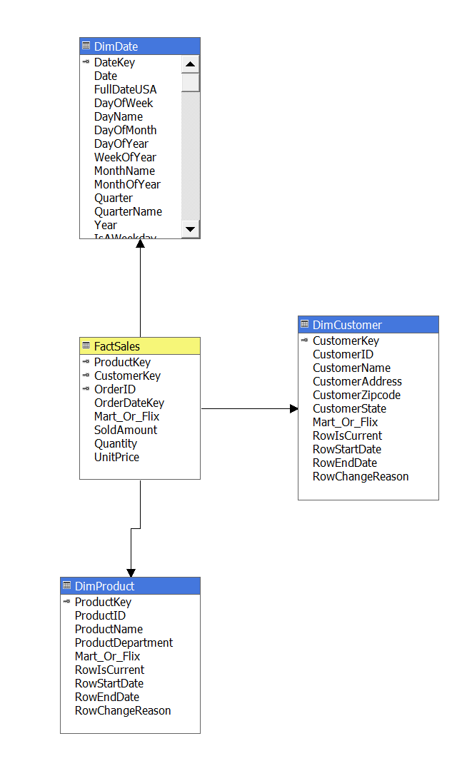
Star schema

Slide 8
MERGED SALES | FUDGE MART | FUDGE FLIX
PRODUCTS | Product ID, Department | Plan ID, Active status
CUSTOMERS | Customer ID | Account ID
ORDER DATE | Order Date | Billing Date
SALES | Order amount | Billed amount

Slide 9
Process
FUDGE MART
STAGE
DW
FUDGE FLIX

Slide 10
ETL
Notes:
We created three packages in our ETL to get data to the staging nd then to the DW.

Slide 11
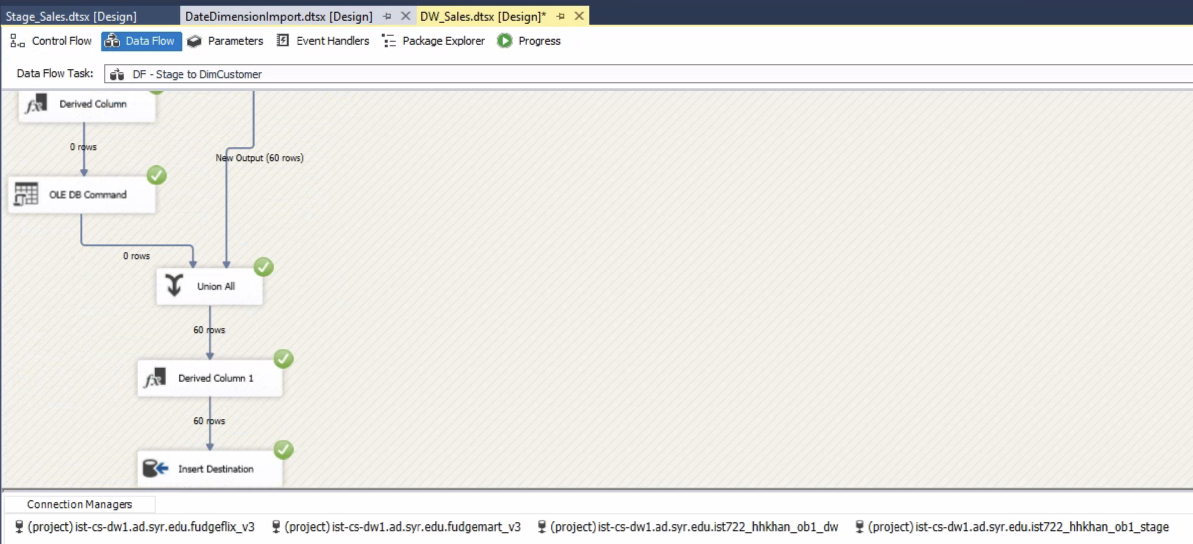
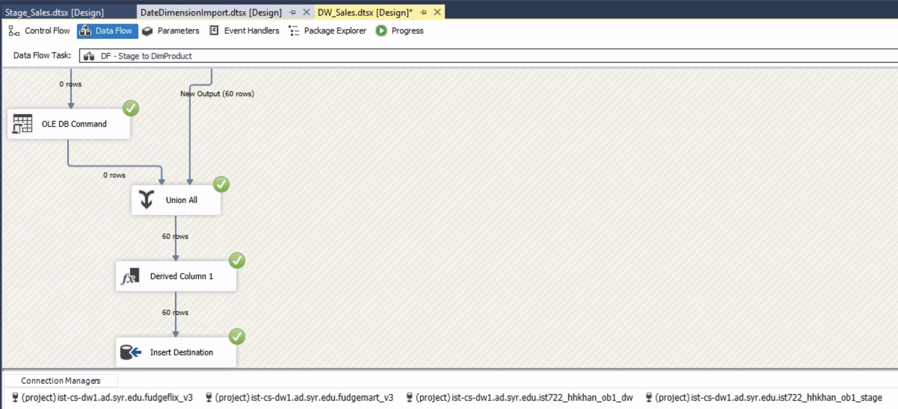
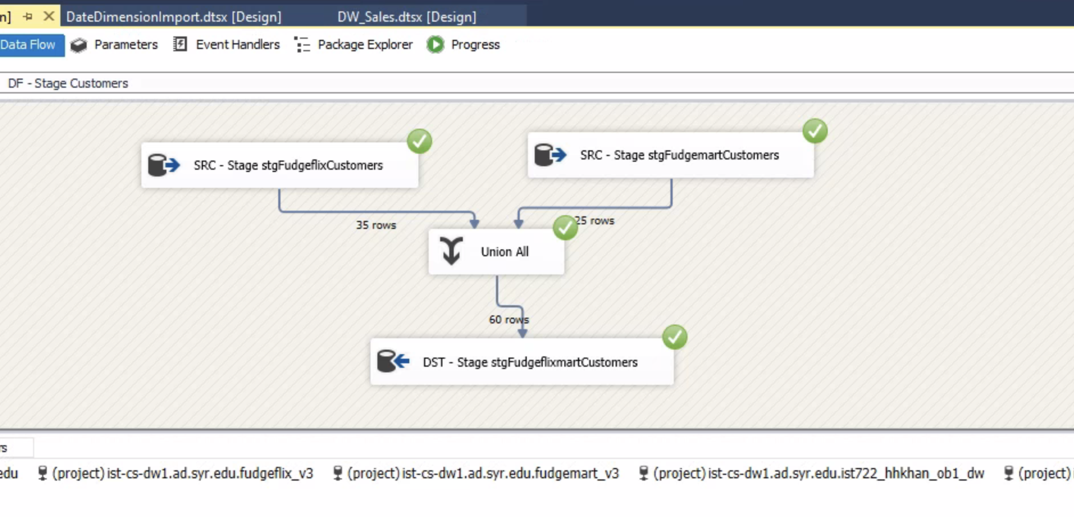
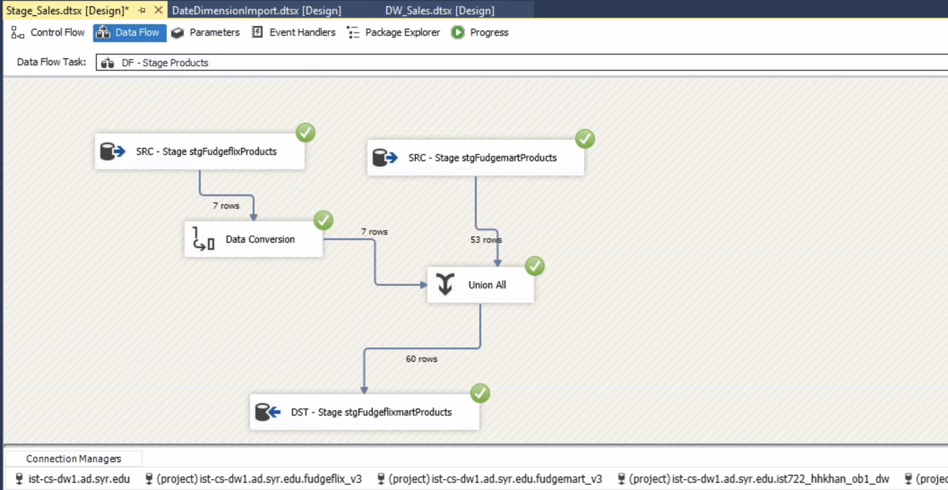

Slide 12
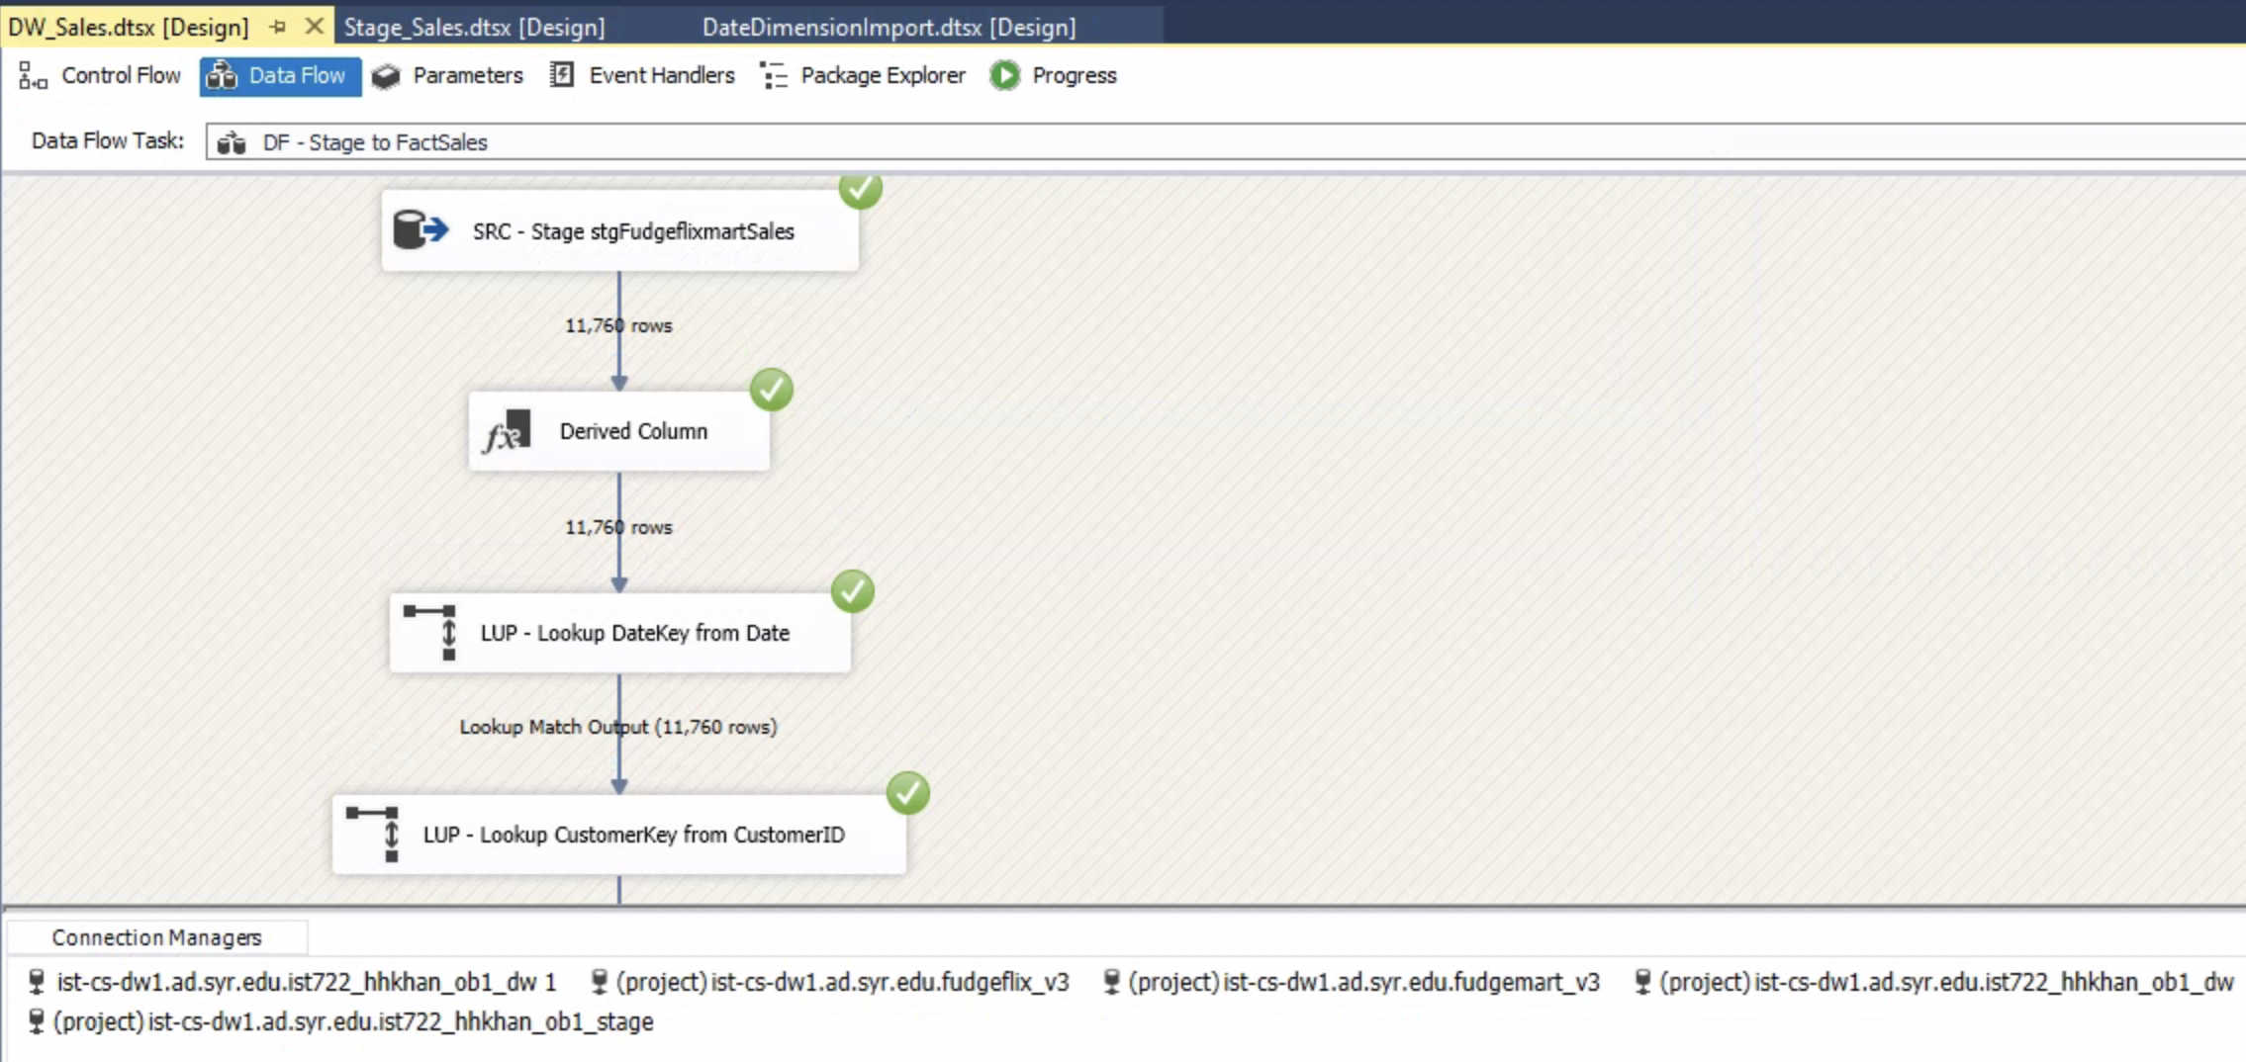
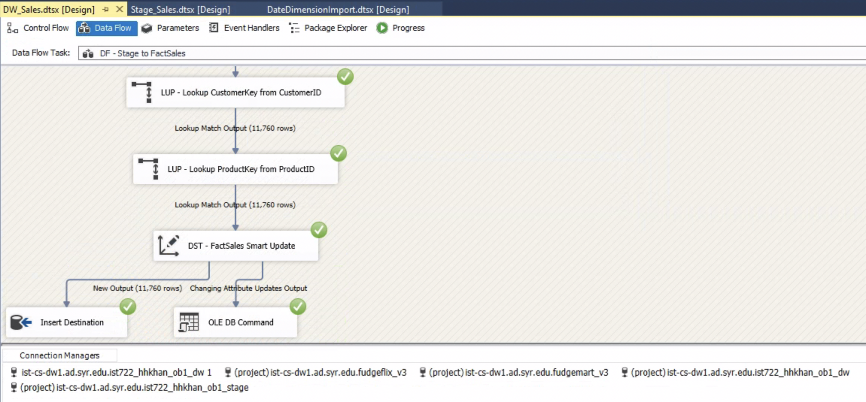

Slide 13
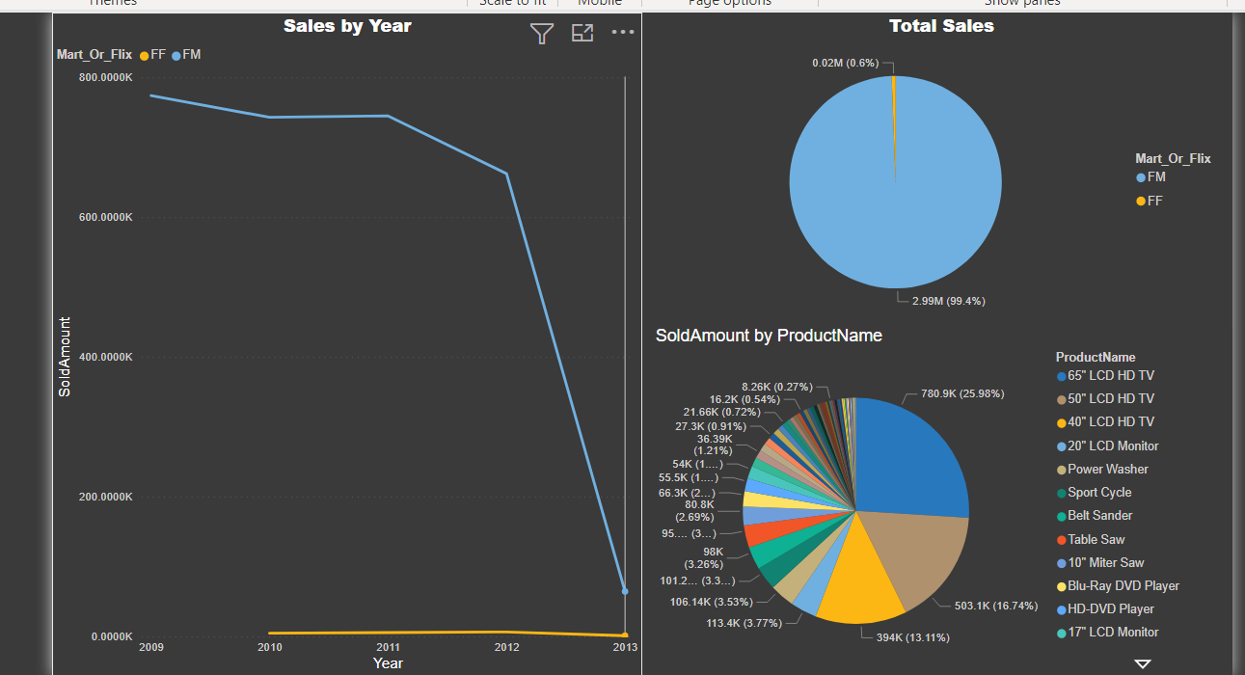
Data visualization-Fudgeflix and Fudgmart Individual Sales

Slide 14
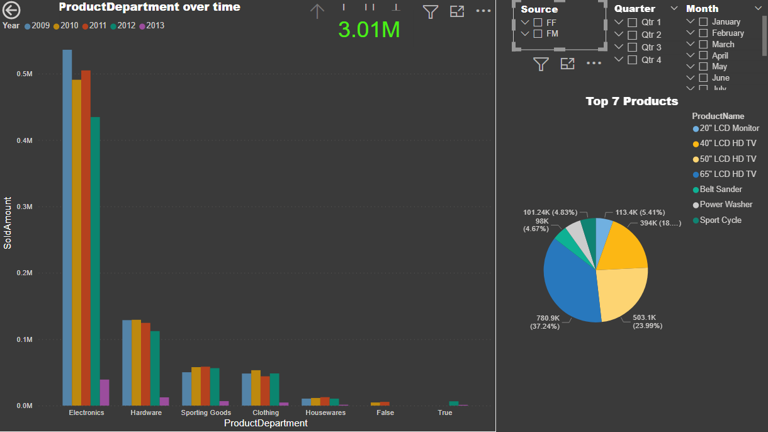
Sales Analysis by Time and Different sources

Slide 15
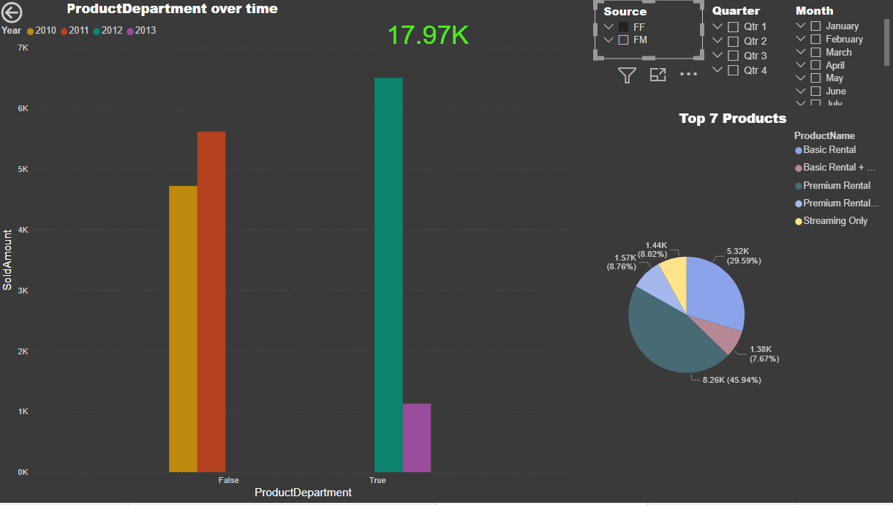
Sales Analysis by Time and For Fudge flix

Slide 16
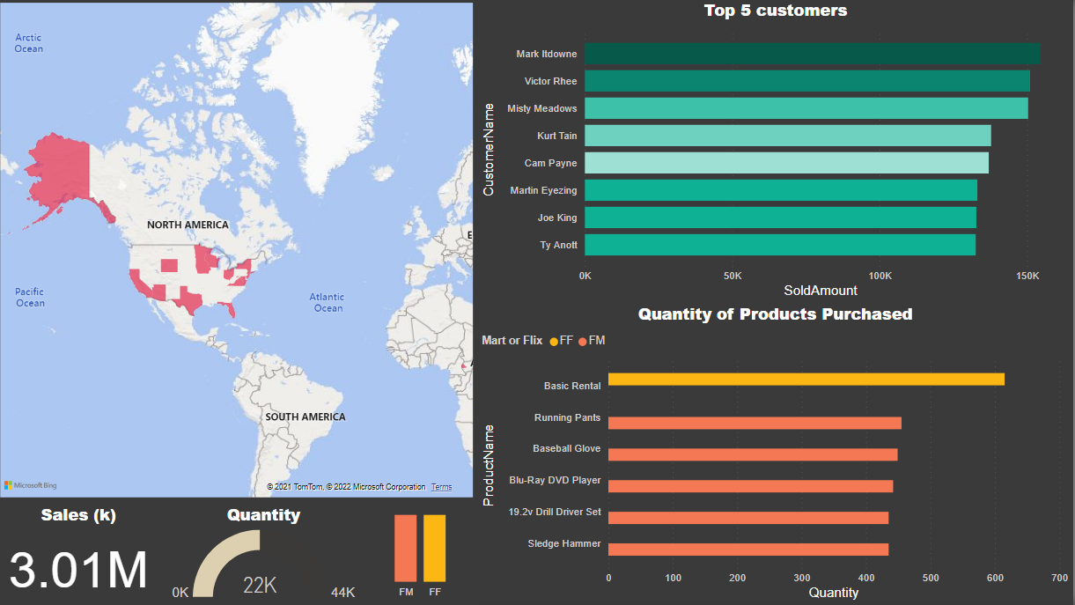
CUSTOMER SALES GENERATION BY VARIOUS SOURCE AND PORDUCTS PURCHASED

Slide 17
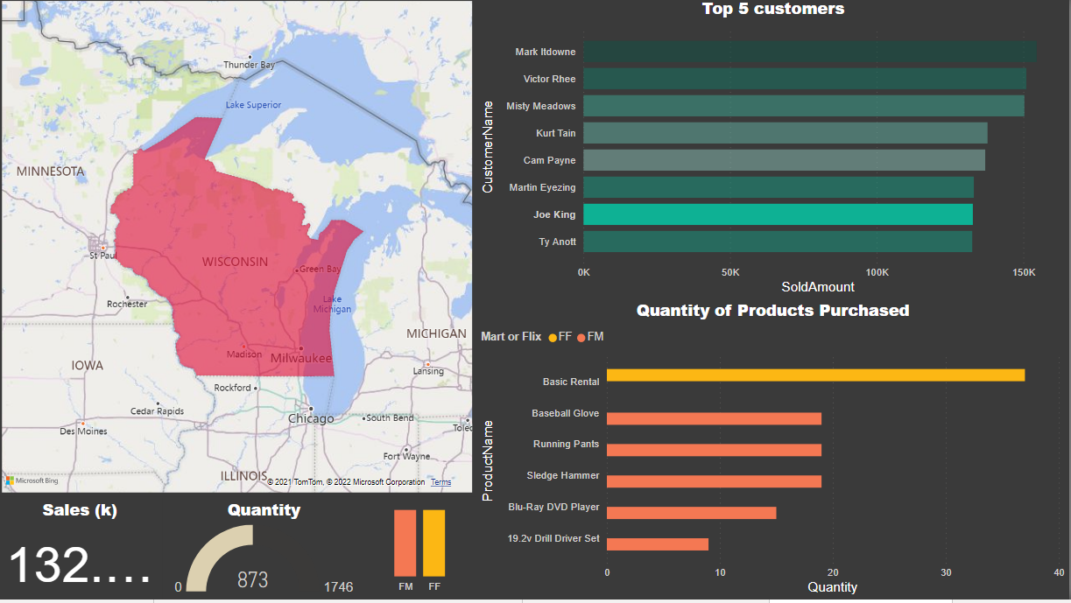
SALES BY JOE KING AND PRODUCTS PURCHASED

Slide 18
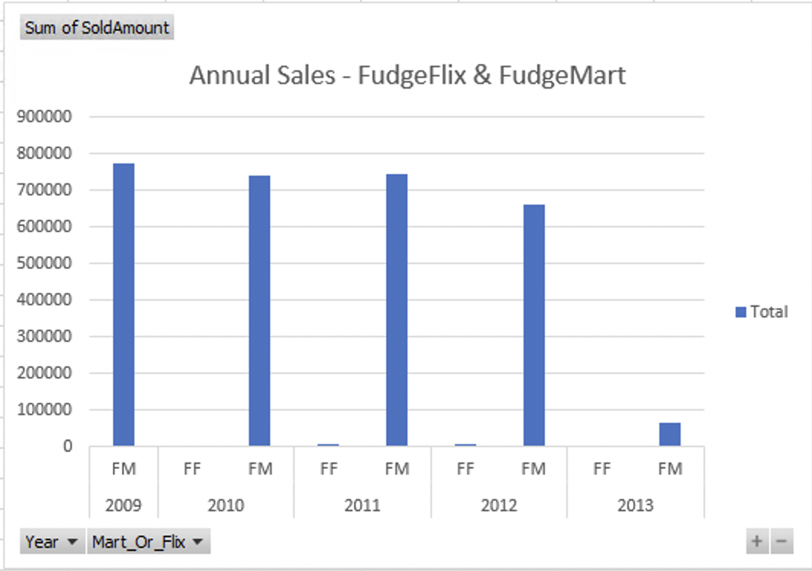
Data visualizations Annual Sales FudgeFlix & Fudgemart

Slide 19
Recommendations
ANNUAL DISCOUNT
Since we have more electronics sales we can offer annual discounts on electronics to increase the revenue
CUSTOMER DISCOUNT
Since we have more sales and customers from Fudgemart, we can offer them discounted Fudgeflix membership
FREE MEMBERSHIP
Since we have less revenues from Fudgeflix maybe we can offer some free membership to attract more customers

Slide 20

Questions?

Slide 21

Thank You

